Slide 1







Information Technology Trends
Susmitha L
06-23-2021

Slide 2



OUTLINE
Executive Summary
Introduction
Methodology
Results
Visualization – Charts
Dashboard
Discussion
Findings & Implications
Conclusion
Appendix

Slide 3

EXECUTIVE SUMMARY
Current Technology Usage Trends based on
By Language
By Database
By Platform
By Web frame
Future Technology Usage Trends based on
Language
Database
Platform
Web frame
Demographics Survey based on
Country & Gender Specifications

Slide 4

INTRODUCTION
Analyze technology trend in software and web development amongst developers around the world
Purpose of this Analysis
Identify the top programming languages, database, platform and
web frame skills in demand
Identify skill requirements for future
Identify human resource gap in the industry
Audience for this Presentation
Business/Industry Leaders
Programmers/Developers
Students(Computer Science)

Slide 5

METHODOLOGY
Data Collection (from different Sources)
→Stack overflow developer 2019 survey
→>GitHub job postings
→Programming languages annual salary
Data Wrangling
Data Exploration
Data Cleaning
• Data Visualization
→Python matplotlib & turtle
→IBM Cognos
→Presentation

Slide 6
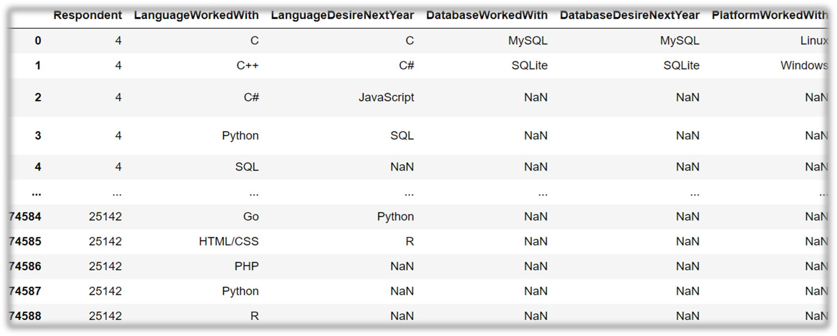
RESULTS

Slide 7
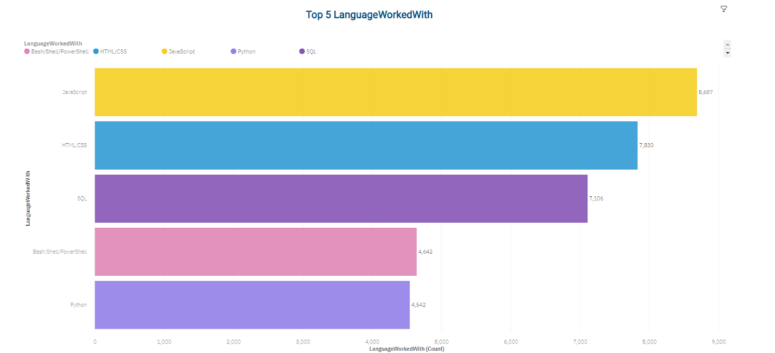
PROGRAMMING LANGUAGE TRENDS – Current Year

Slide 8
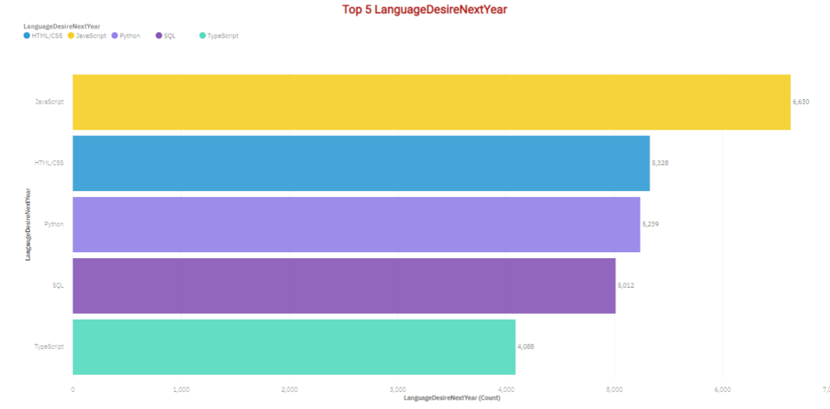
PROGRAMMING LANGUAGE TRENDS- Next Year

Slide 9
PROGRAMMING LANGUAGE TRENDS - FINDINGS & IMPLICATIONS
Findings :
JavaScript is top trending language in the world
Python and TypeScript are becoming more and more popular
HTML/CSS and SQL still has great portion in language usage trend
Implications :
Web developments and Web developers are still in high demands
JavaScript and TypeScript are crucial to learn for developers
Python is the new trending language, especially popular in AI fields

Slide 10
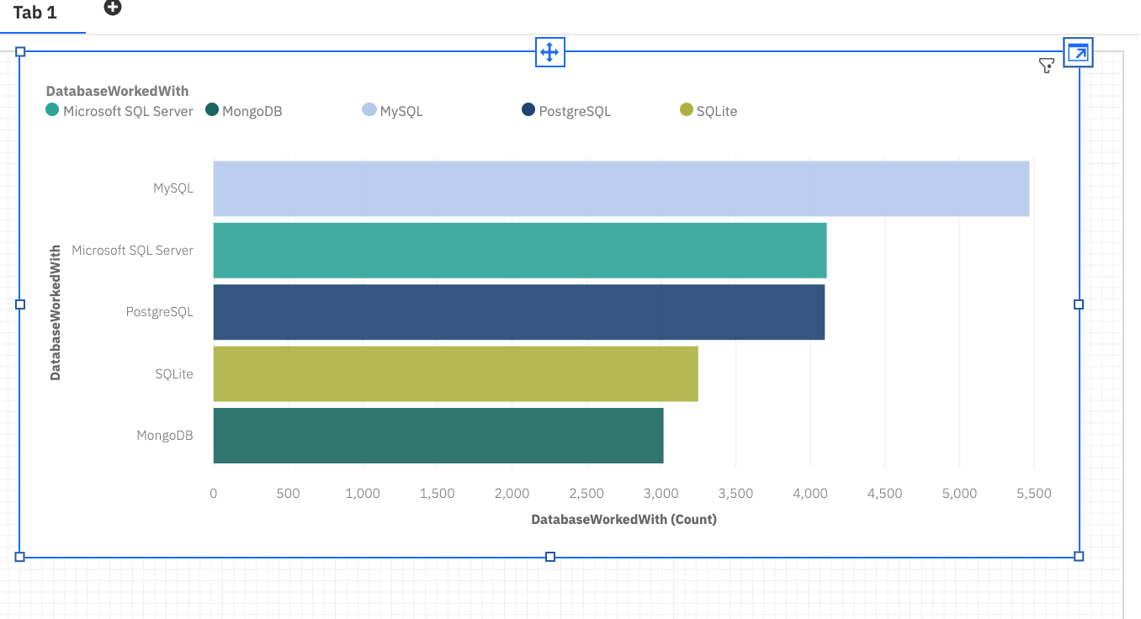
DATABASE TRENDS-Current Year

Slide 11
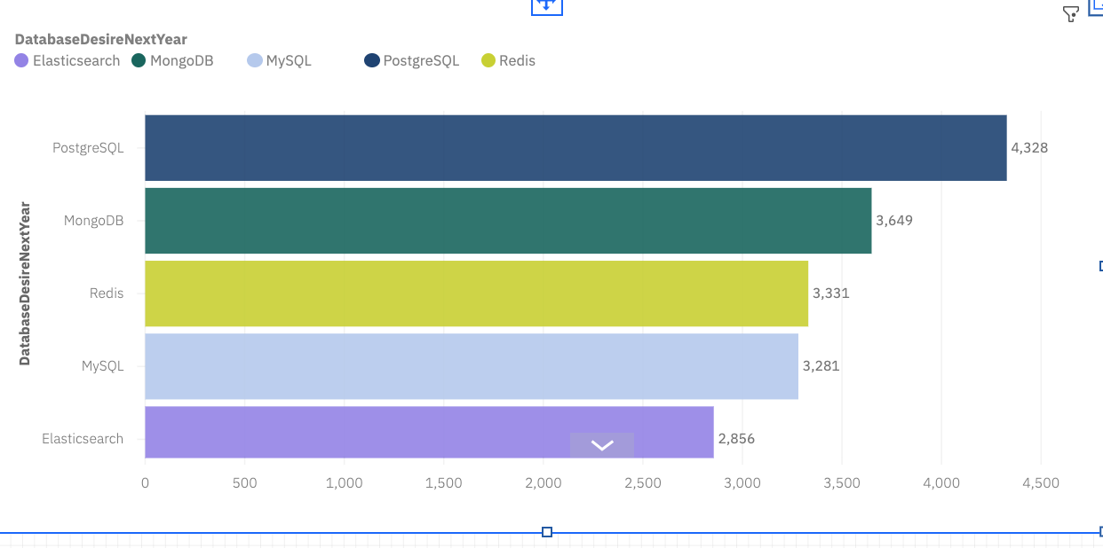
DATABASE TRENDS-Next Year

Slide 12
DATABASE TRENDS - FINDINGS & IMPLICATIONS
Implications
→Open-source databases like MySQL are still preferable
→Software development and Big Data technology still requires SQL
→NoSQL databases will make an impact for relational databases
Findings
→MySQL is the most popular database
→There are still a lot of companies using Microsoft SQL Server
→MongoDB and Redis are the most favorable NoSQL database

Slide 13

DASHBOARD Below is the link to check Dashboard with different visualizations
https://dataplatform.cloud.ibm.com/dashboards/97cb0e53-2bca-4dbb-ba86-dc695c270431/view/7365db2023ec3ce14ab3f6e4079079577b31250cbabb8b56d2d37b490b312097a96046c3c82d4f59d8115632a7bf100b98

Slide 14
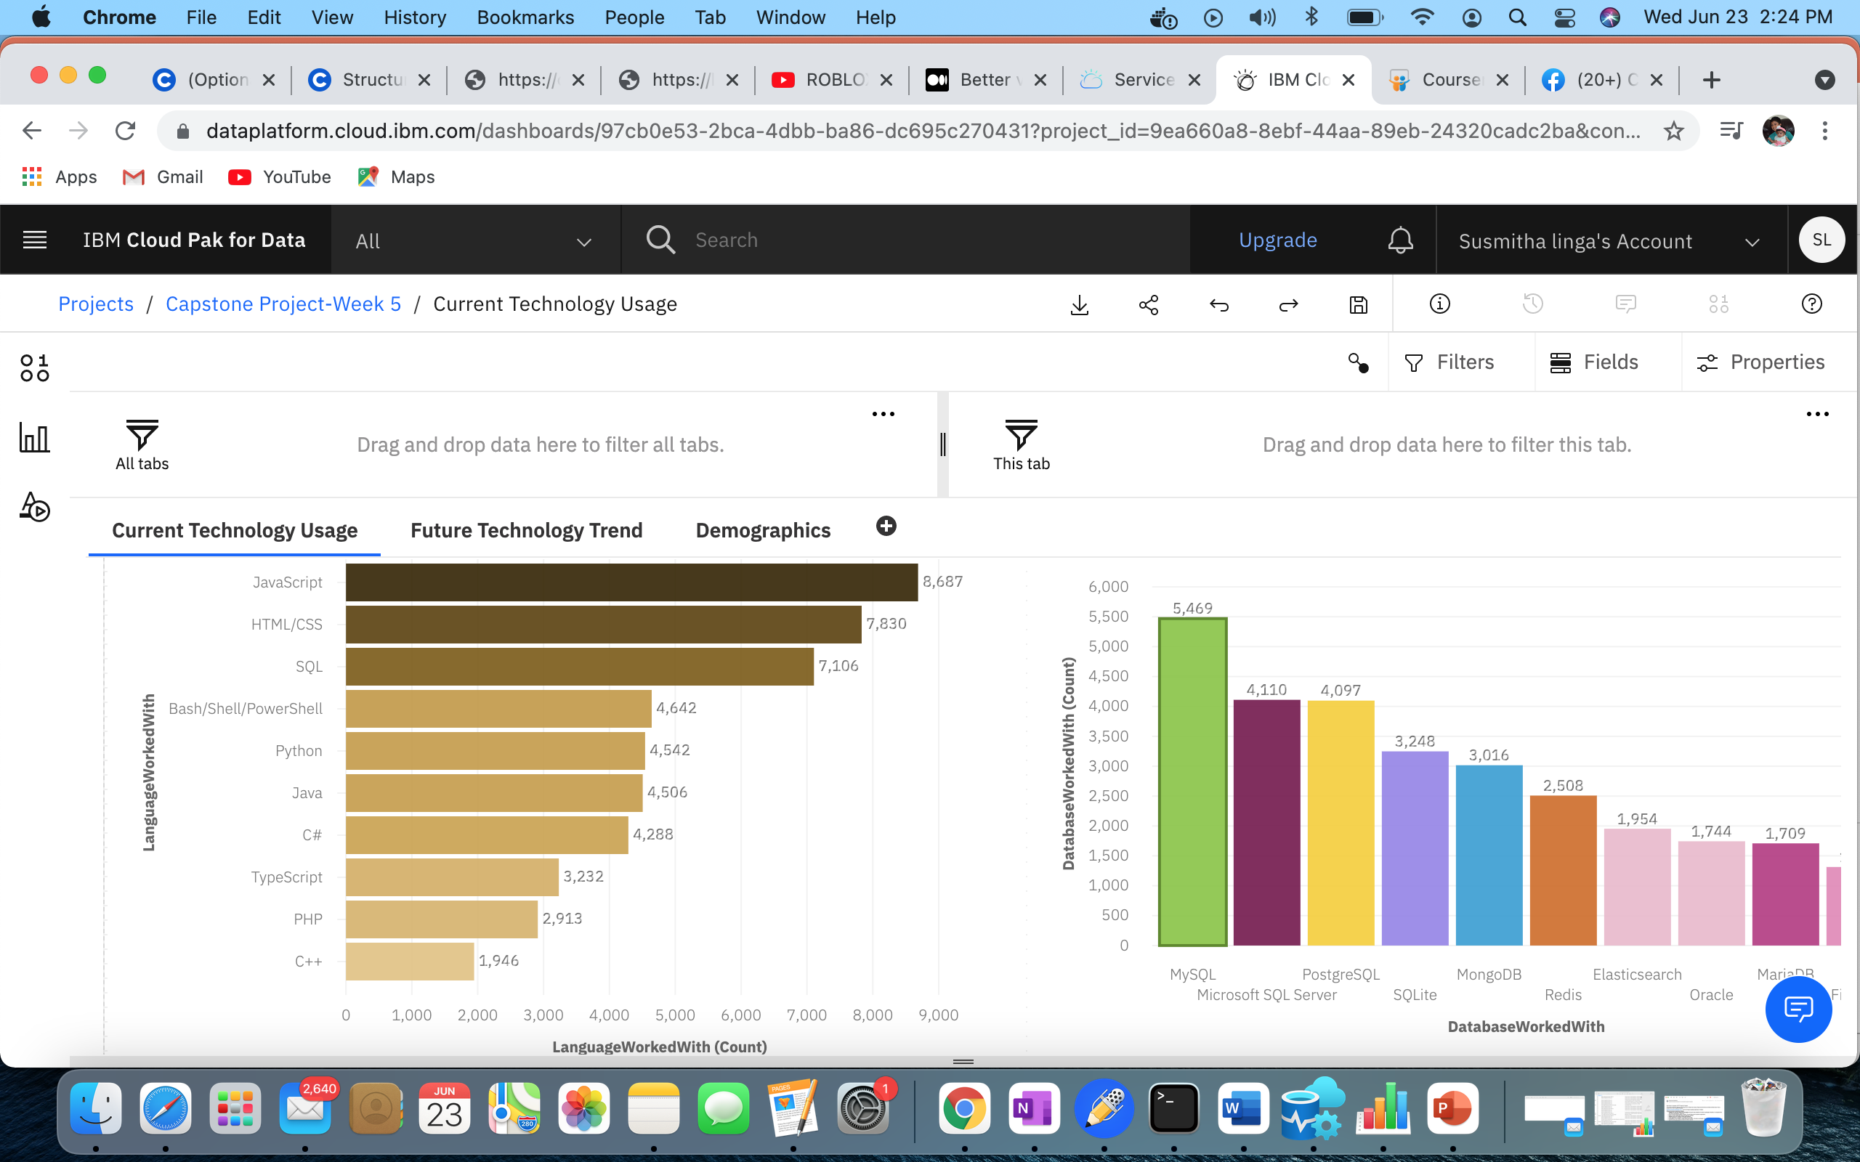
TAB 1: Different plots to show Current Technology trends

Slide 15
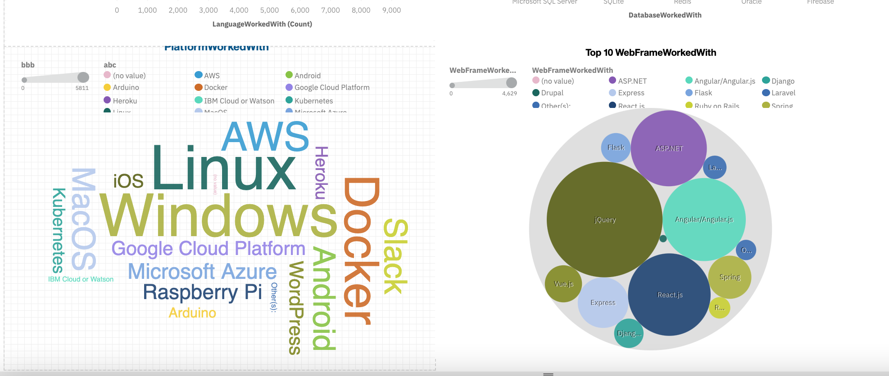
Tab 1:Continues…

Slide 16
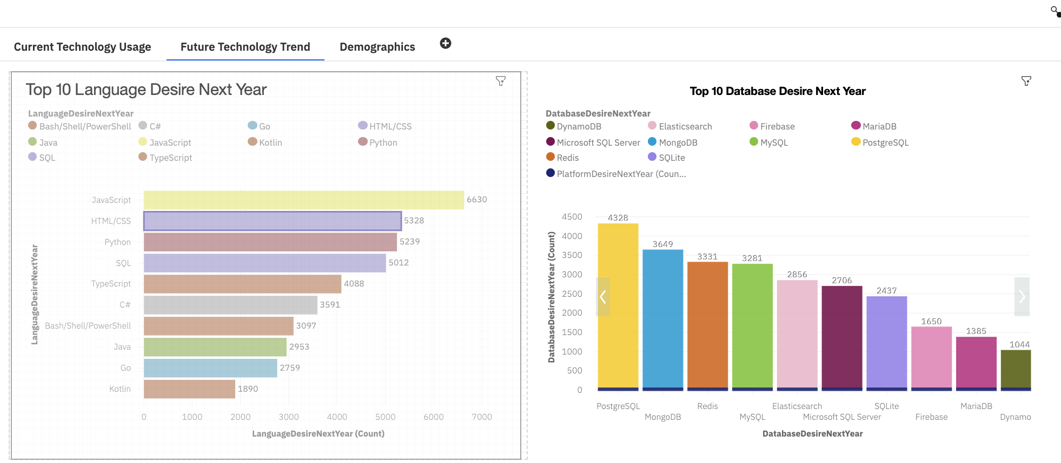
TAB 2: Visualizations for Future Technology Trends

Slide 17
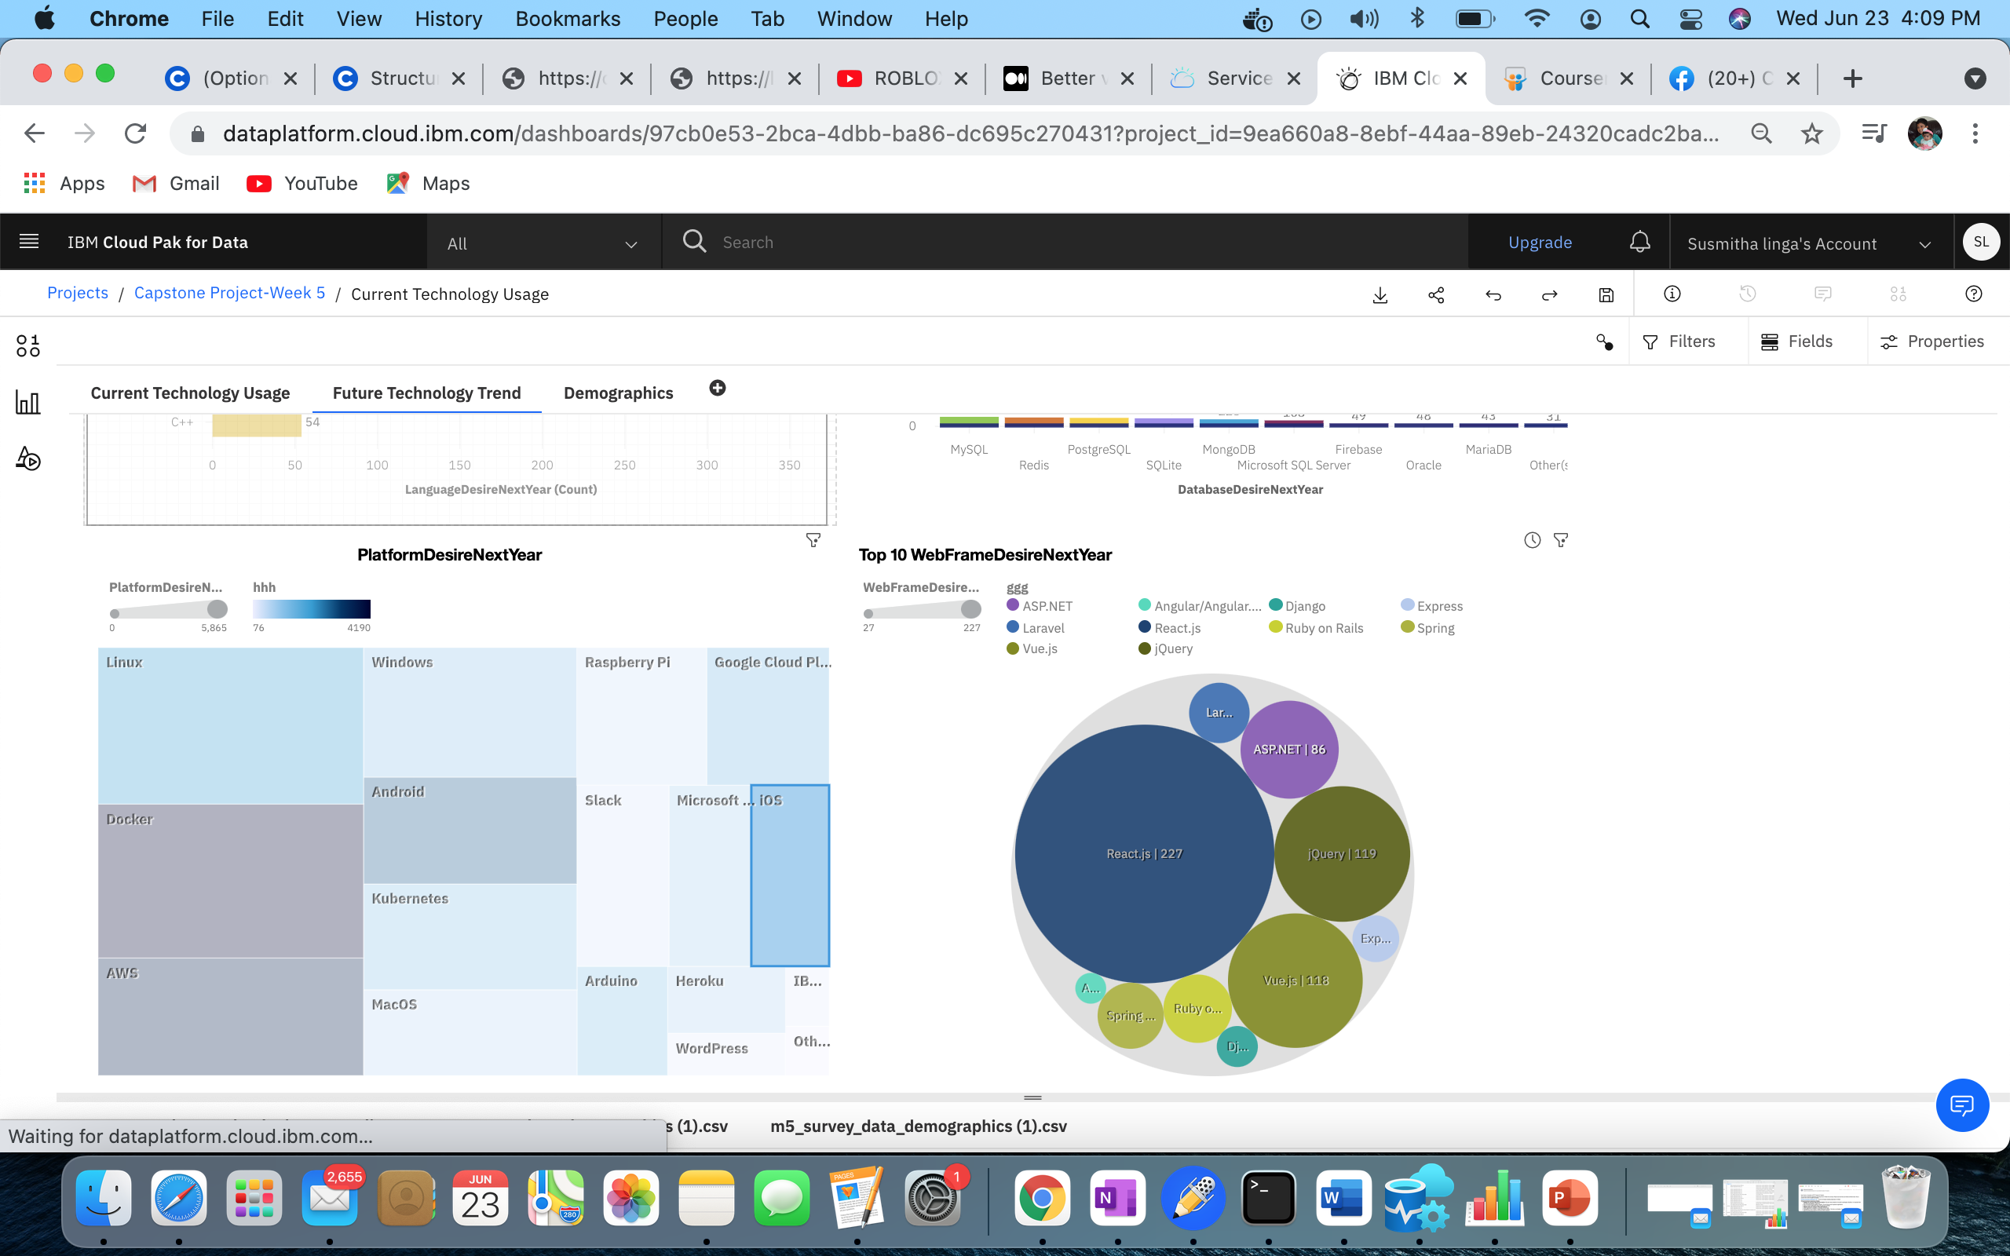
Tab 2:Continues..

Slide 18
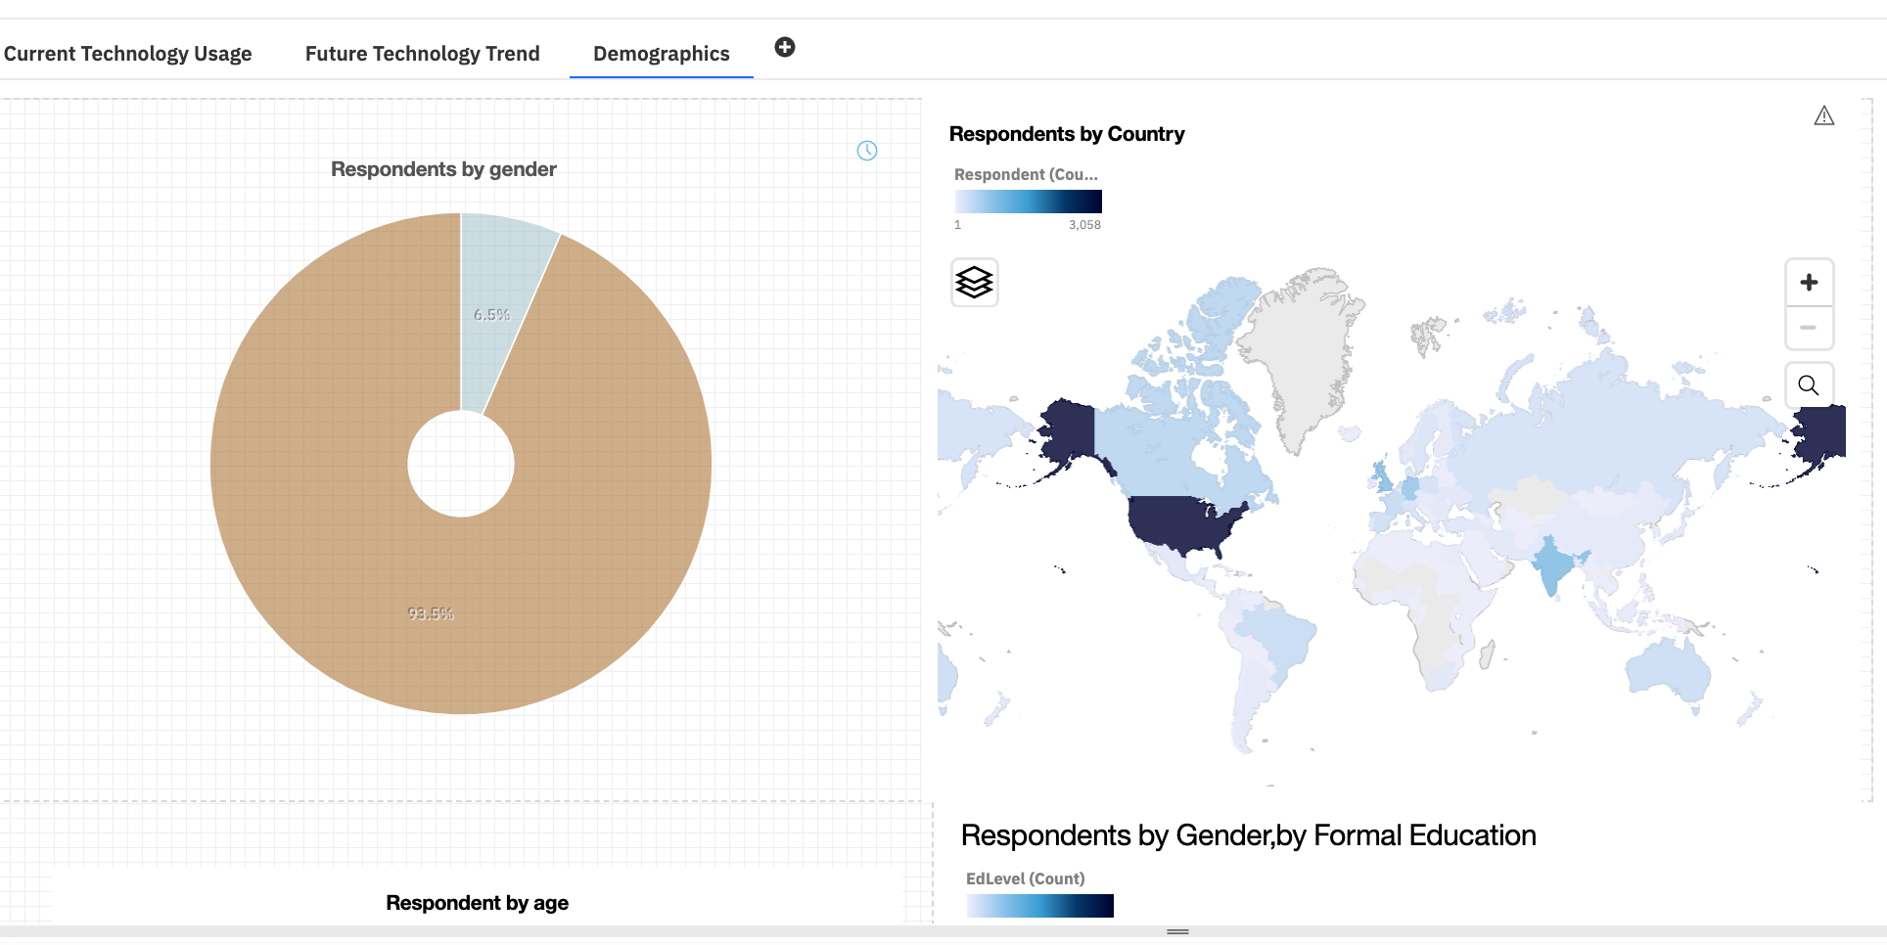
TAB 3: Demographics

Slide 19
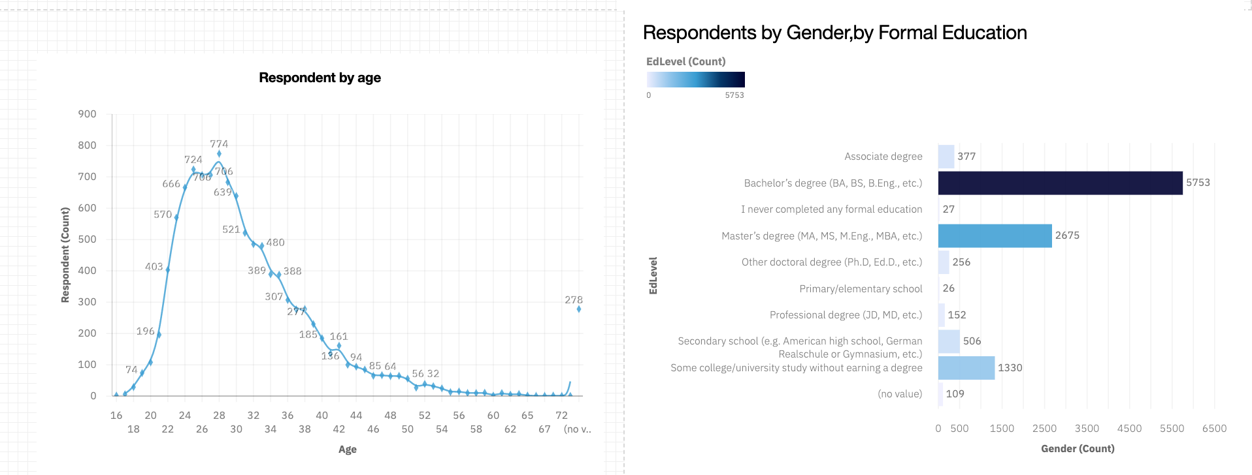
Tab3: Contines..

Slide 20
DISCUSSION
Technology Usage Trend Now and Future
Gender, Age and Education Discrimination in IT Industry

Slide 21
OVERALL FINDINGS & IMPLICATIONS
Findings
• Technology trends changes every year
• USA is the top technology country • There are extreme gender and age
discrimination
• Docker and AWS are the most popular platform
Implications
• Programmers should always follow the latest technology trends
• More countries should have the equal chance to be exposed to new technology
• Gender and Age should not be one of the concerns or benefits of Employment

Slide 22

CONCLUSION
Technology Trends
Programming Languages, Database,
Platform and Web frame Trends
Demographics Trends
Gender and Education
Programming Languages Trends and Salary Trends

Slide 23

APPENDIX Need to work
Include any relevant additional charts, or tables that you may have created during the analysis phase.
IBM Cognos Dashboard Embedded (CDE) is an AI-fueled business intelligence service that supports the entire data analytics cycle, from discovery to operationalization.
It provides users with data discovery capabilities to visually explore and interact with their data to identify the key insights for improving data driven decisions.
Users can perform data discovery and then quickly assemble that information into interactive, visually appealing dashboards; all without the need of formal training

Slide 24
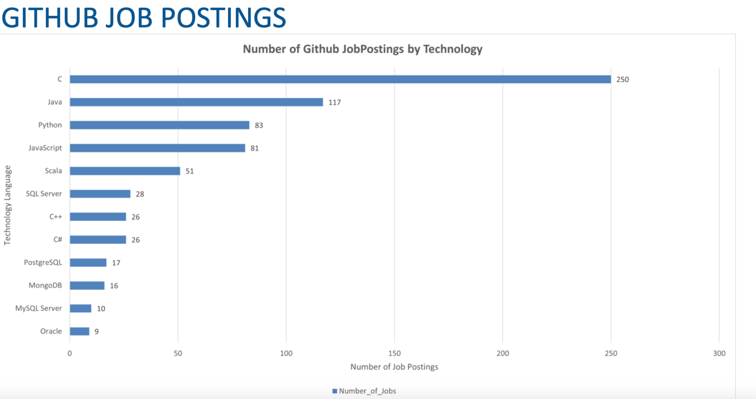
GITHUB JOB POSTINGS

Slide 25
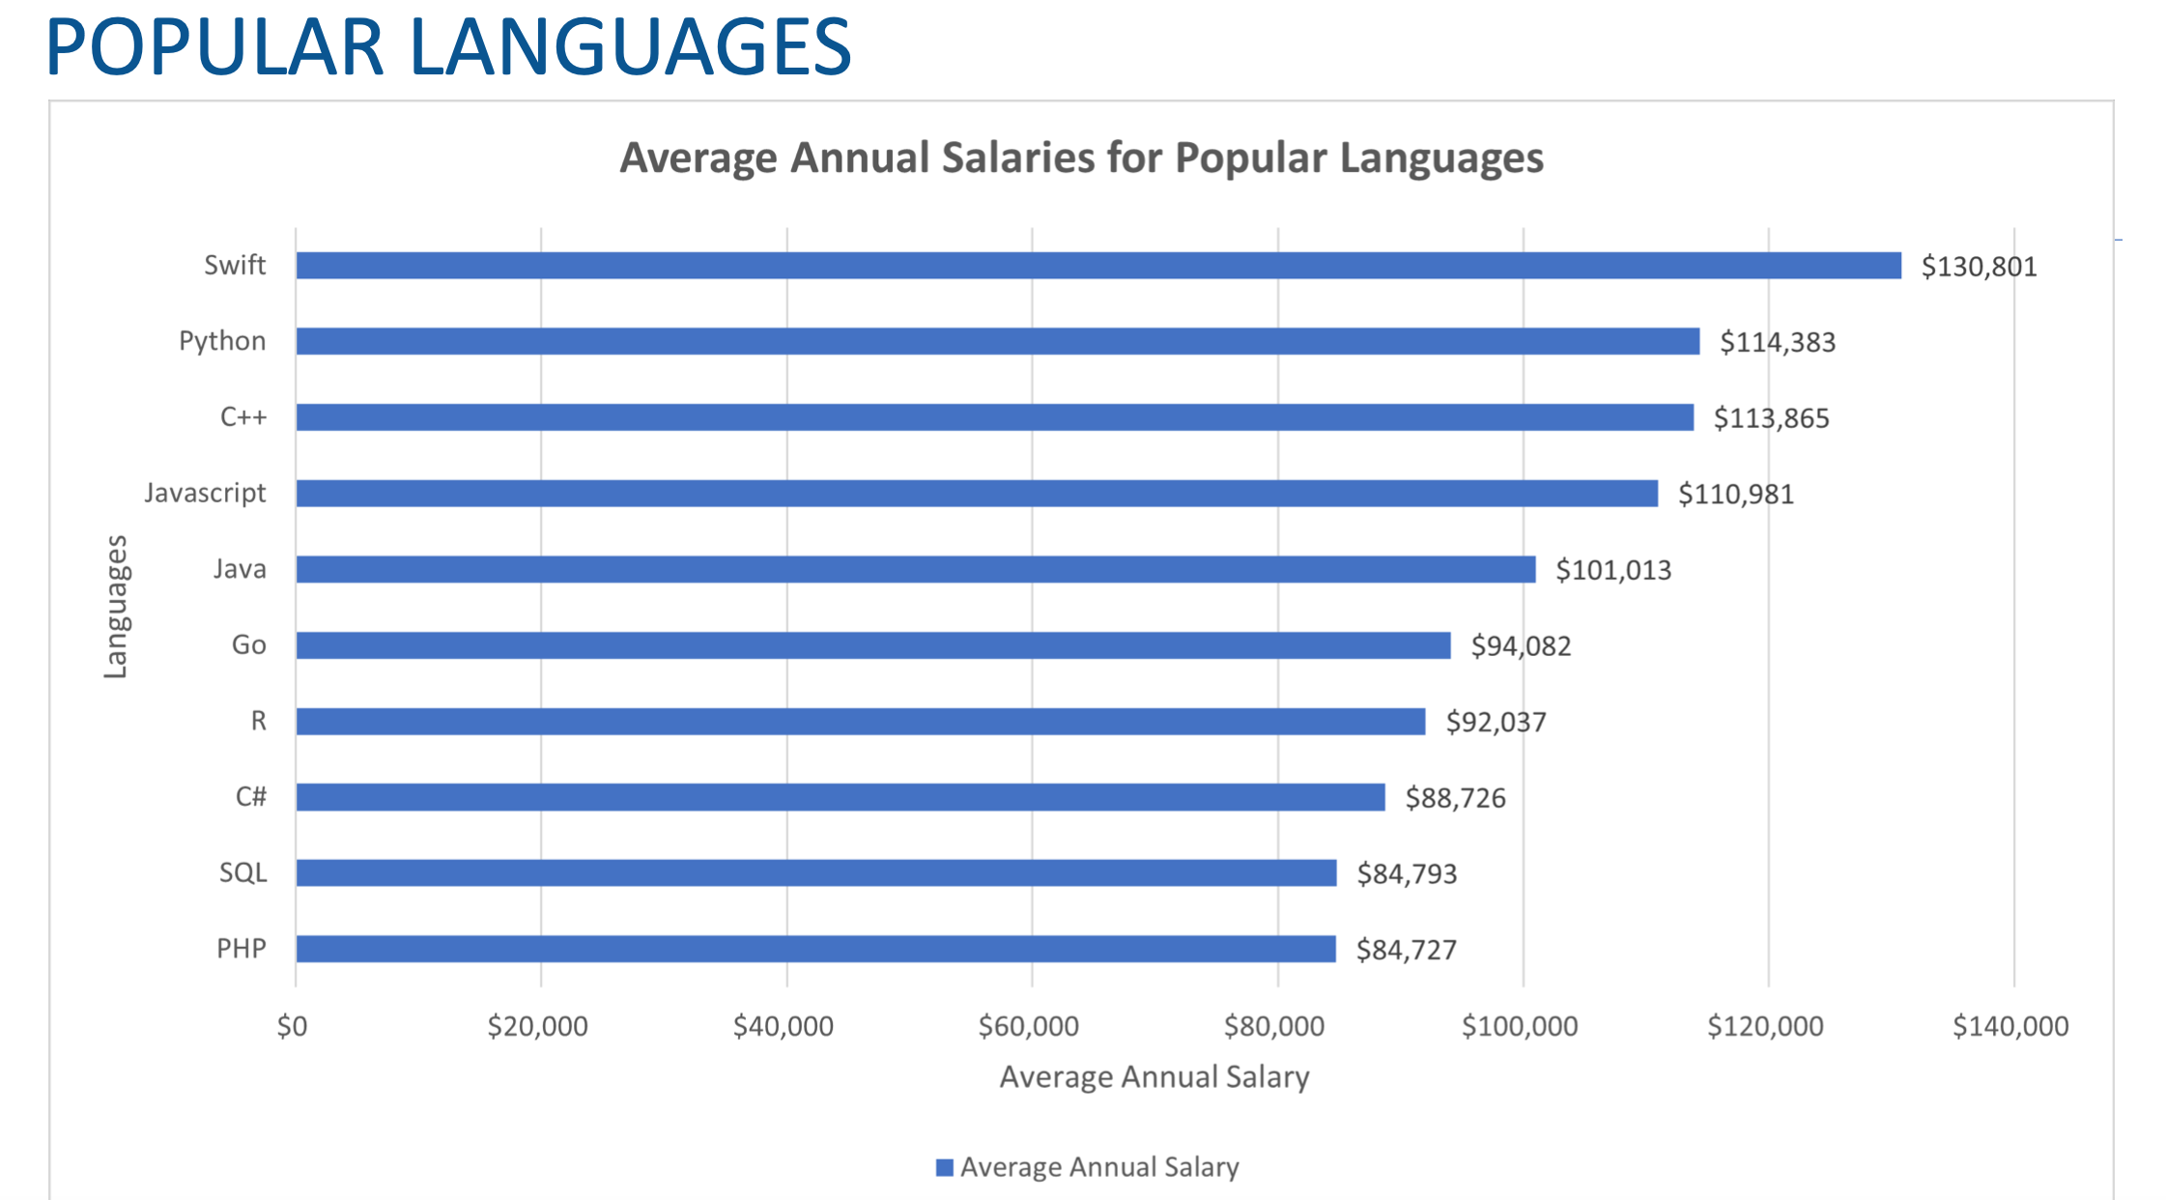
POPULAR LANGUAGES

